Slide 1
Distributed Systems
Distributed
Coordination-Based Systems
Chapter 13

Slide 2
Course/Slides Credits
Note: all course presentations are based on those developed by Andrew S. Tanenbaum and Maarten van Steen. They accompany their "Distributed Systems: Principles and Paradigms" textbook (1st & 2nd editions).
http://www.prenhall.com/divisions/esm/app/author_tanenbaum/custom/dist_sys_1e/index.html
And additions made by Paul Barry in course CW046-4: Distributed Systems
http://glasnost.itcarlow.ie/~barryp/net4.html

Slide 3
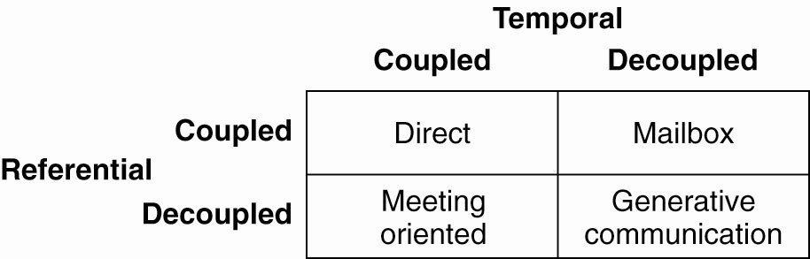
Introduction To Coordination Models
A taxonomy of coordination models (adapted from Cabri et al., 2000)

Slide 4
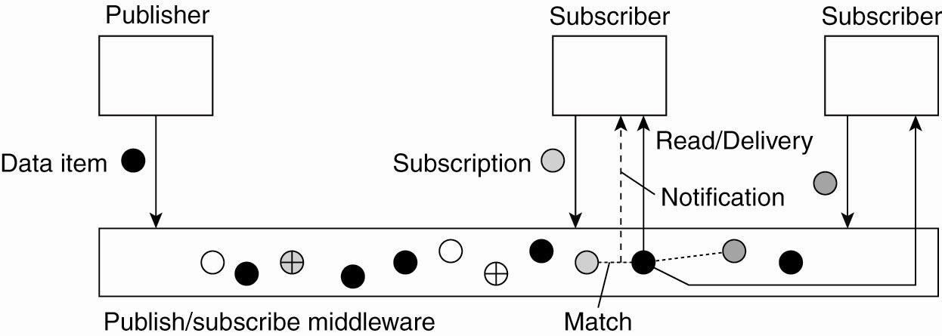
Overall Approach
The principle of exchanging data items between publishers and subscribers

Slide 5
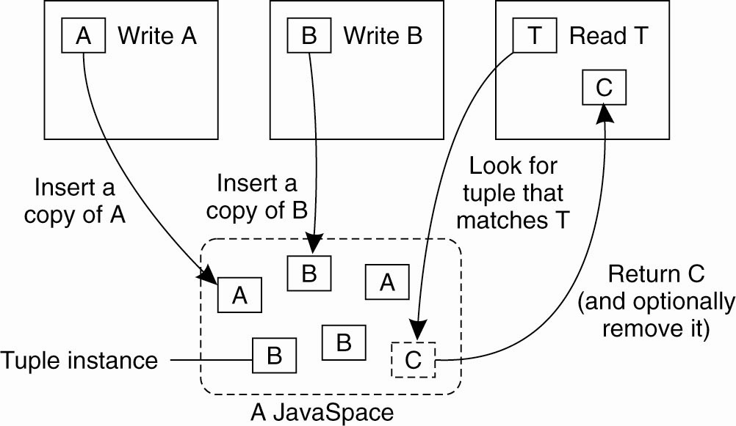
Example: Jini and JavaSpaces
The general organization of a JavaSpace in Jini

Slide 6
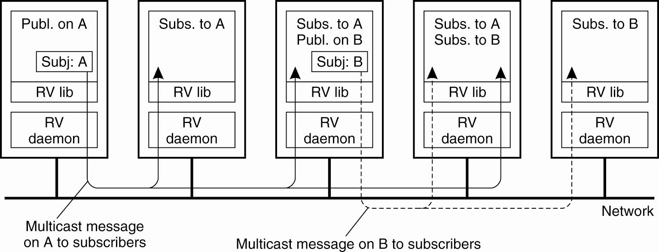
Example: TIB/Rendezvous
The principle of a publish/subscribe system
as implemented in TIB/Rendezvous

Slide 7
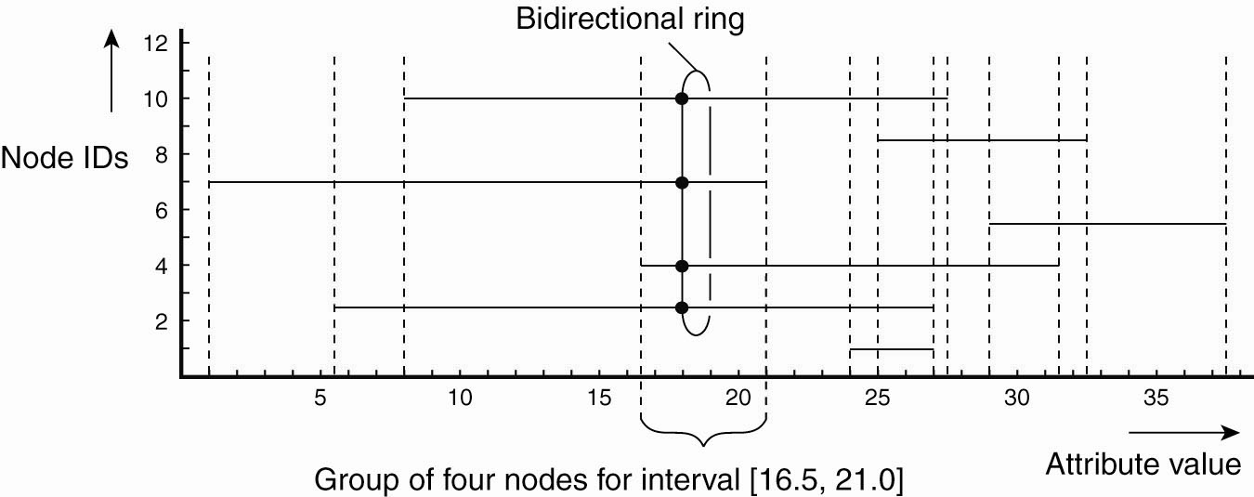
Example: A Gossip-Based Publish/Subscribe System
Grouping nodes for supporting range queries in a peer-to-peer publish/subscribe system

Slide 8
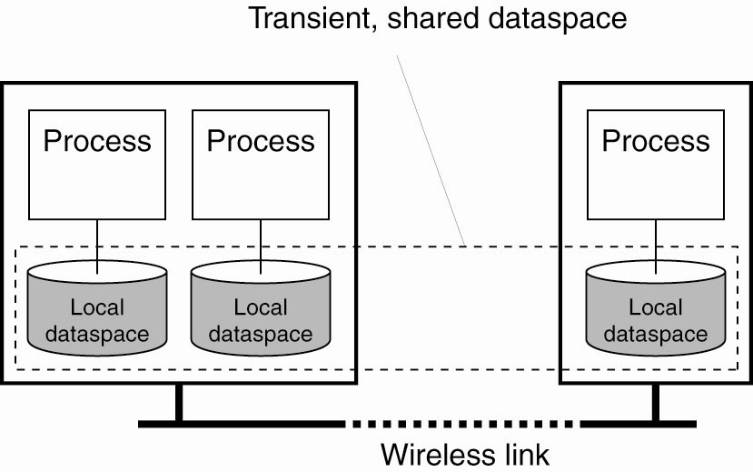
Example: Lime
Transient sharing of local dataspaces in Lime

Slide 9
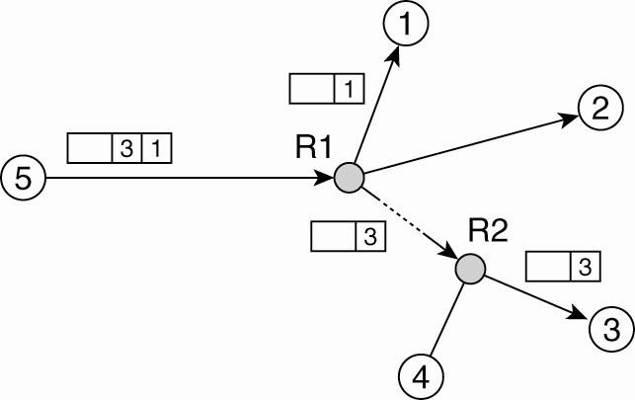
Content-Based Routing (1)
Naive content-based routing

Slide 10
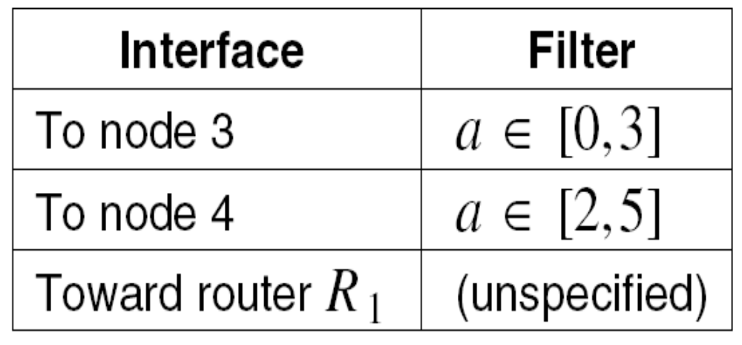
Content-Based Routing (1)
A partially filled routing table

Slide 11
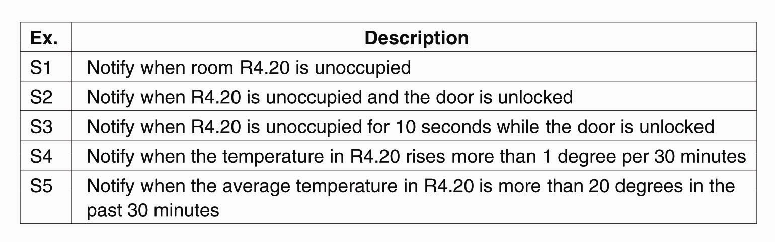
Describing Composite Events (1)
Examples of events in a distributed system

Slide 12
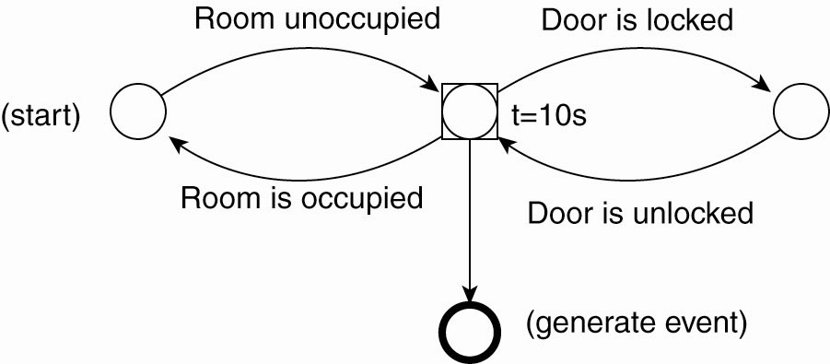
Describing Composite Events (2)
The finite state machine for subscription S3

Slide 13
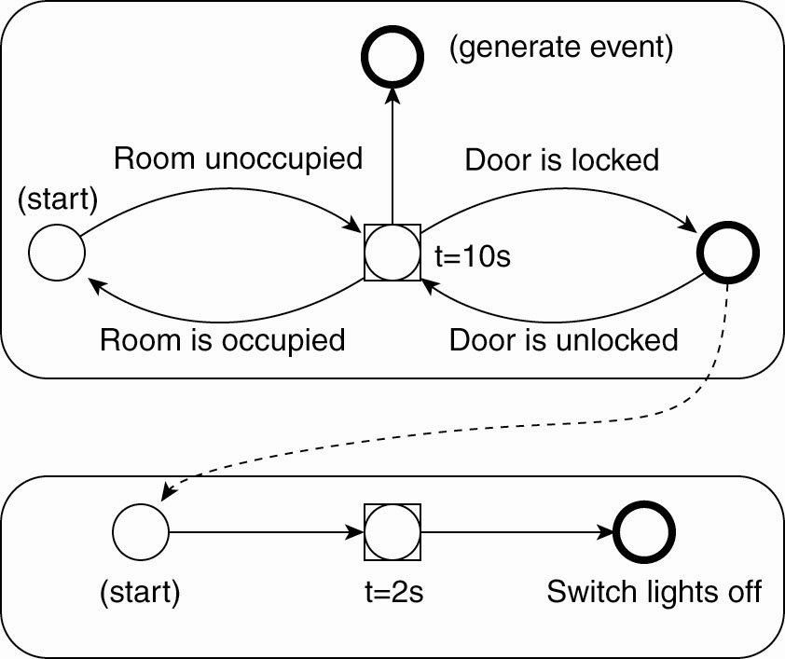
Describing Composite Events (3)
Two coupled FSMs

Slide 14
General Considerations to Static Approaches (1)
An efficient distributed implementation of a JavaSpace has to solve two problems:
How to simulate associative addressing without massive searching.
How to distribute tuple instances among machines and locate them later.

Slide 15
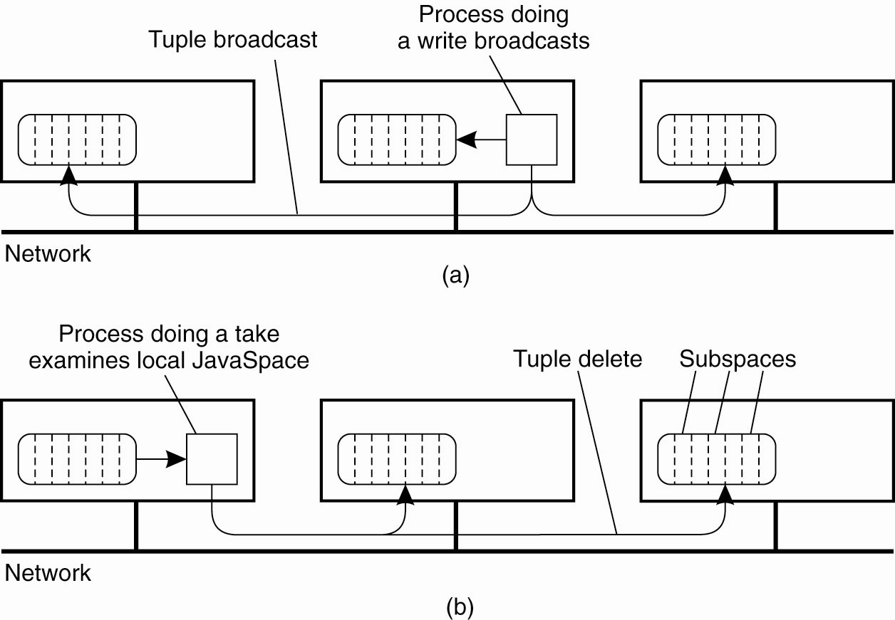
General Considerations to Static Approaches (2)
A JavaSpace can be replicated on all machines. The dotted lines show the partitioning of the JavaSpace into subspaces.
(a) Tuples are broadcast on write.

Slide 16
General Considerations to Static Approaches (3)
A JavaSpace can be replicated on all machines. The dotted lines show the partitioning of the JavaSpace into subspaces. (b) reads are local, but the removing an instance when calling take must be broadcast.

Slide 17
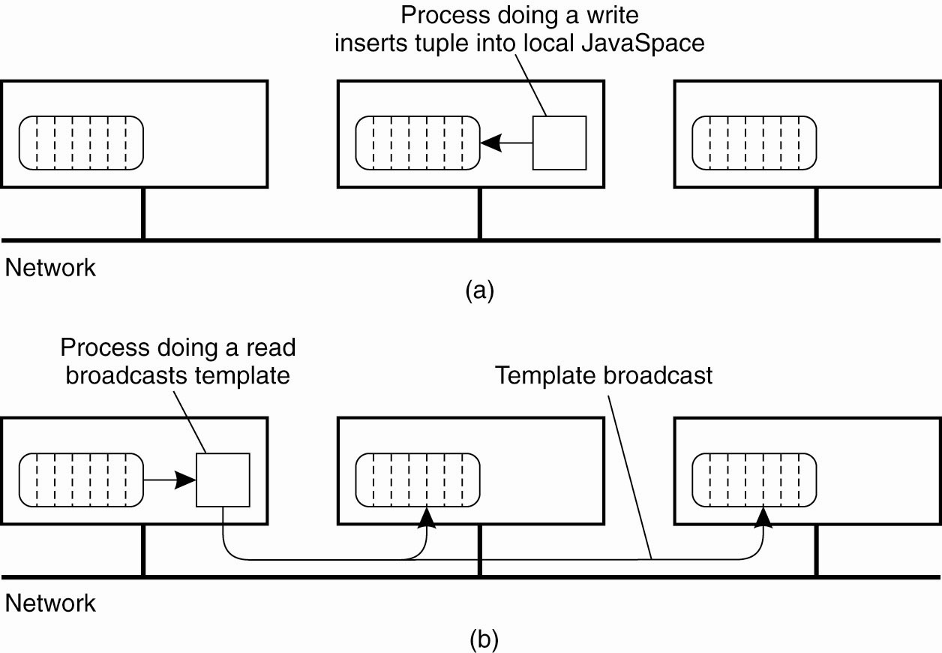
General Considerations to Static Approaches (4)
Nonreplicated JavaSpace. (a) A write is done locally.

Slide 18
General Considerations to Static Approaches (5)
Nonreplicated JavaSpace. (b) A read or
take requires the template tuple to be broadcast in order to find a tuple instance.

Slide 19
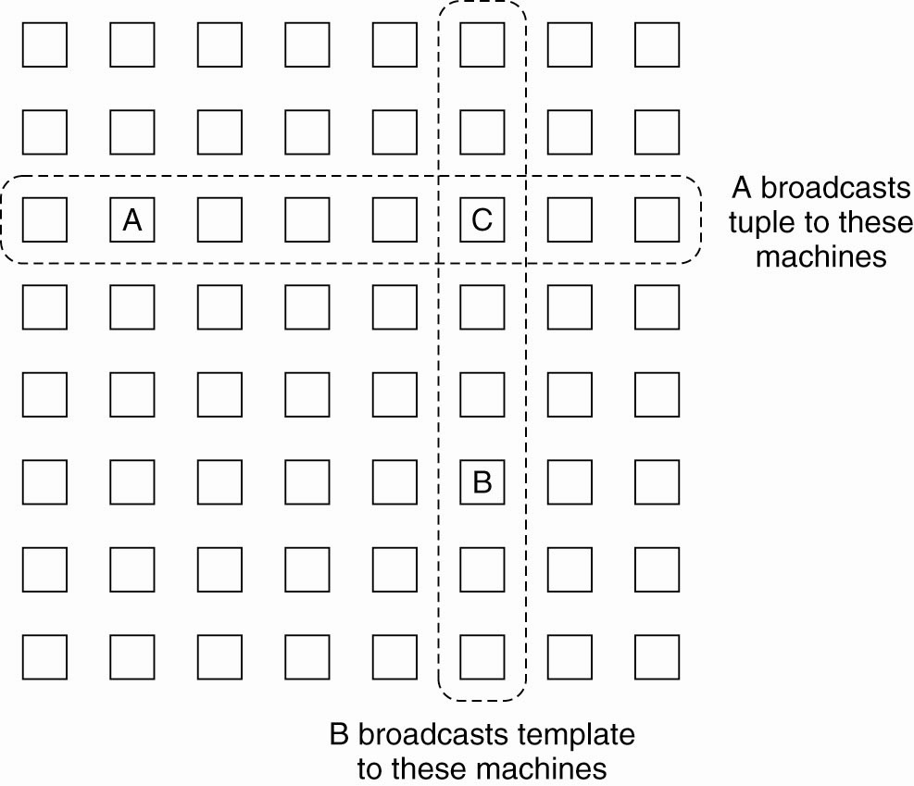
General Considerations to Static Approaches (6)
Partial broadcasting of tuples and template tuples

Slide 20
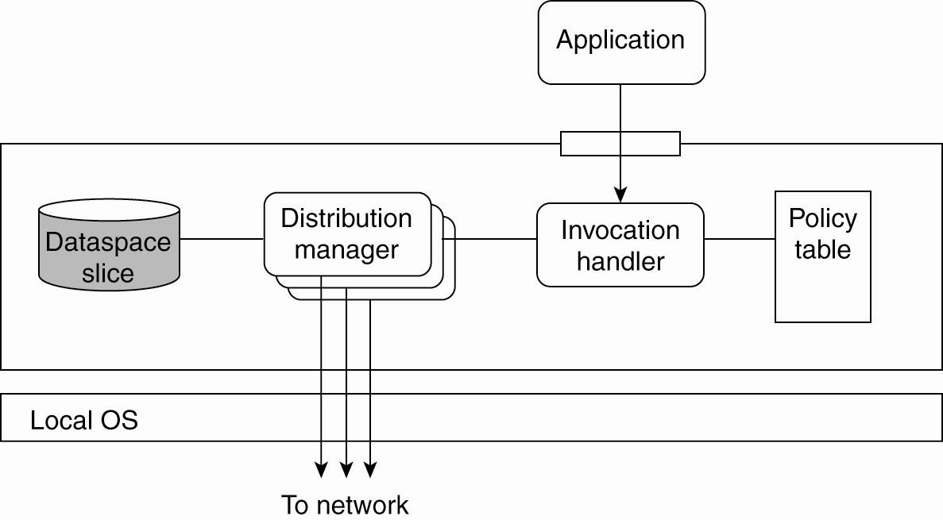
GSpace Overview
Internal organization of a GSpace kernel

Slide 21
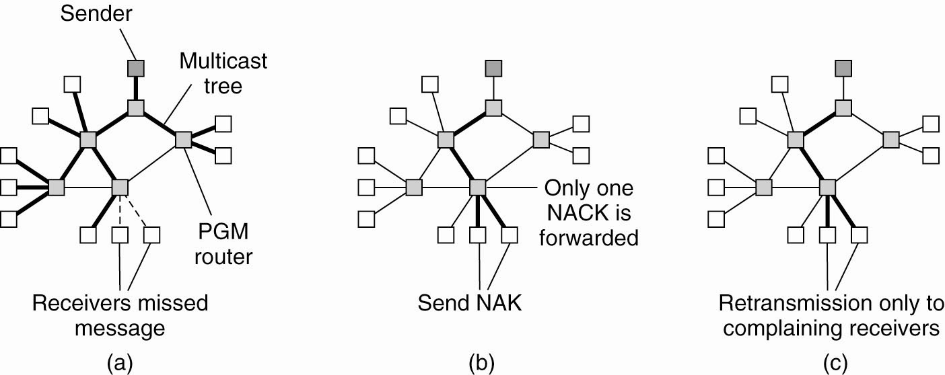
Example: Fault Tolerance in TIB/Rendezvous (1)
The principle of PGM.
(a) A message is sent along a multicast tree.

Slide 22
Example: Fault Tolerance in TIB/Rendezvous (2)
The principle of PGM.
(b) A router
will pass only a single NAK for each message.

Slide 23
Example: Fault Tolerance in TIB/Rendezvous (3)
The principle of PGM.
(c) A message is retransmitted only to receivers that have asked for it.

Slide 24
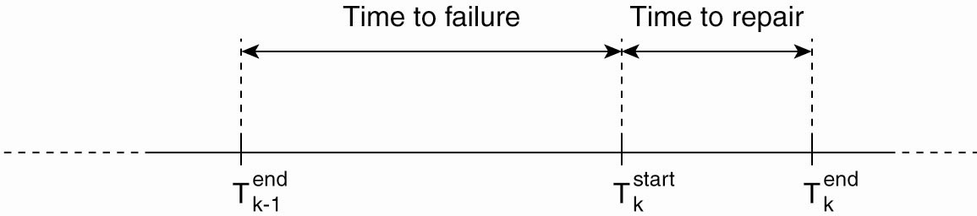
Fault Tolerance in Shared Dataspaces
The time line of a node experiencing failures

Slide 25
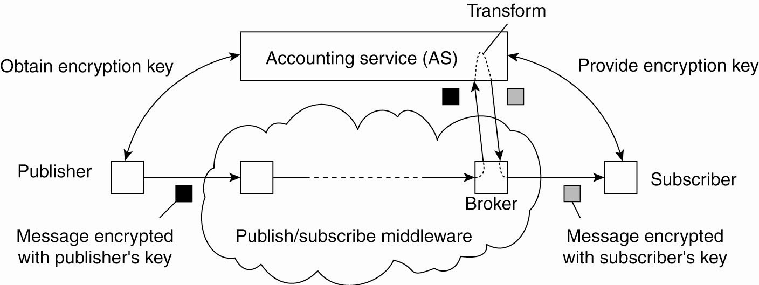
Decoupling Publishers from Subscribers
Decoupling publishers from subscribers
using an additional trusted service

